Slide 1
Capella Tufu Bay,Hainan 海南土福湾嘉佩乐度假酒店

Slide 2

我们提供
嘉入卓越 星途璀璨 CRAFTING YOUR LEGENDARY JOURNEY WITH CAPELLA
WE OFFER

Slide 3
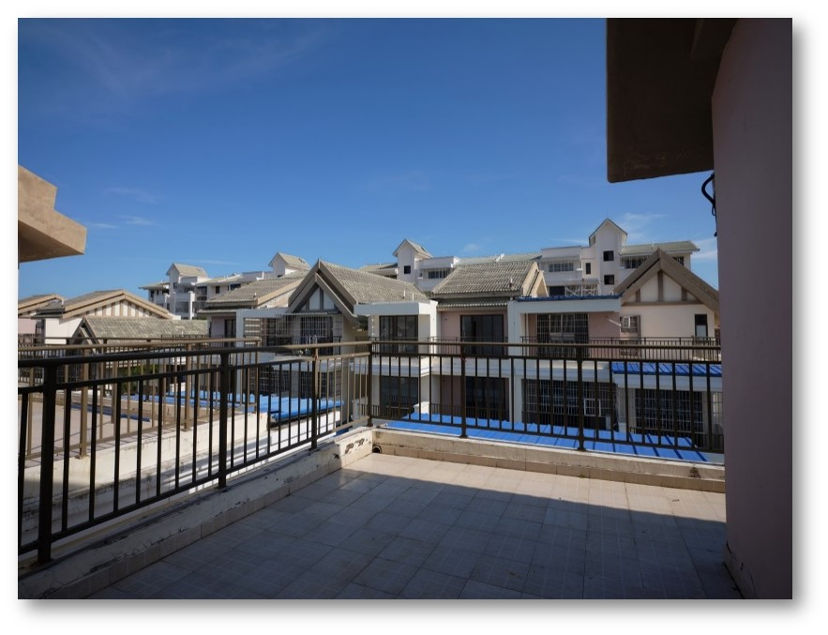
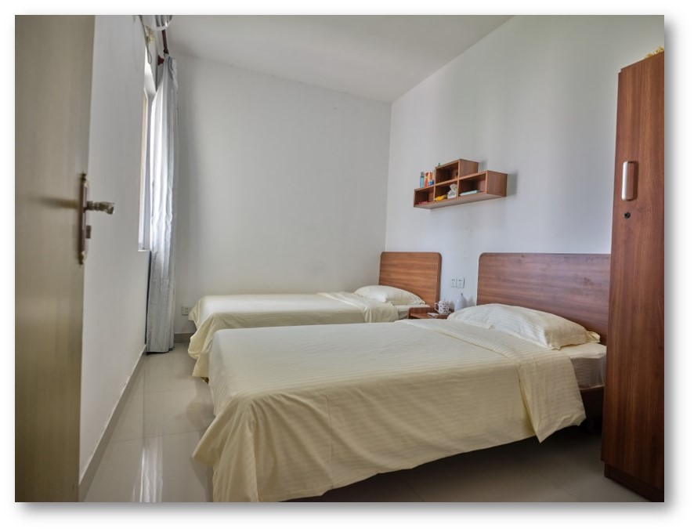
晓满园宿舍
嘉入卓越 星途璀璨 CRAFTING YOUR LEGENDARY JOURNEY WITH CAPELLA
双人间

Slide 4
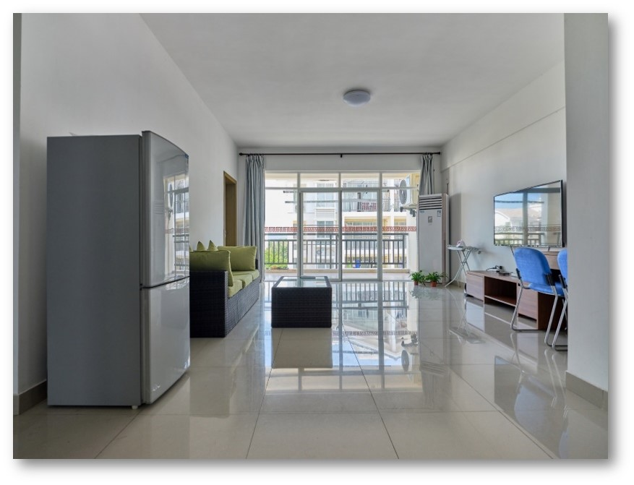
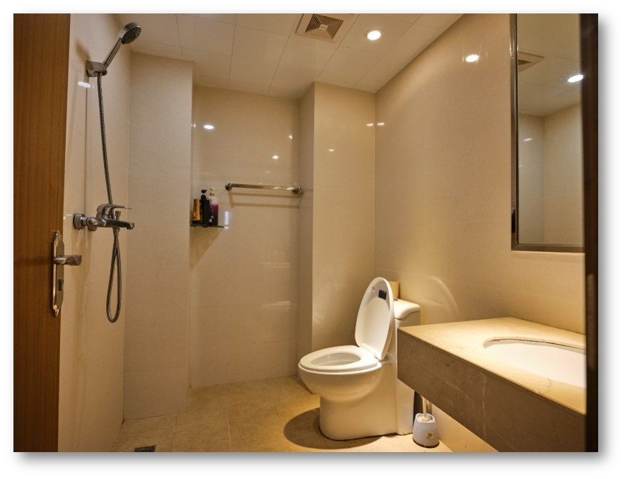
晓满园宿舍
嘉入卓越 星途璀璨 CRAFTING YOUR LEGENDARY JOURNEY WITH CAPELLA
独立卫浴、沙发、冰箱、
空调、电视机

Slide 5
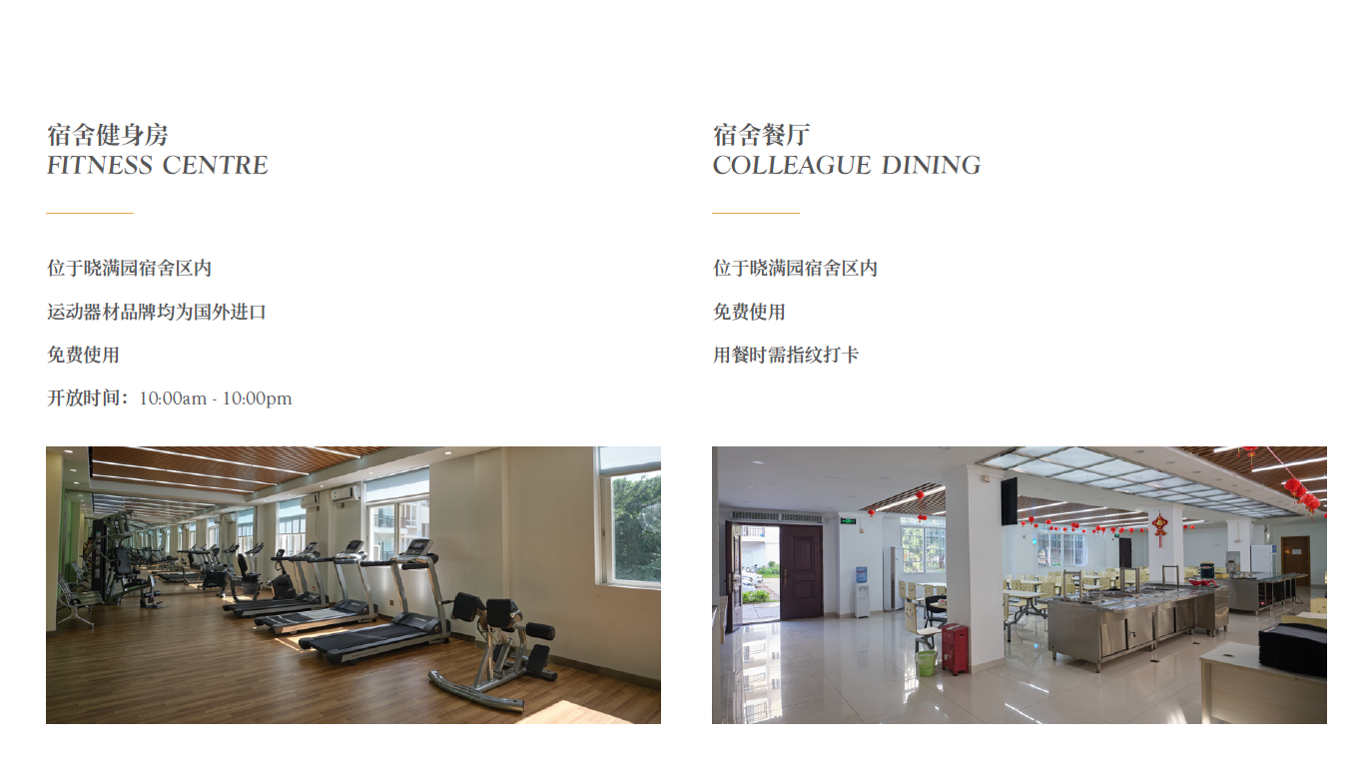
嘉入卓越 星途璀璨 CRAFTING YOUR LEGENDARY JOURNEY WITH CAPELLA

Slide 6
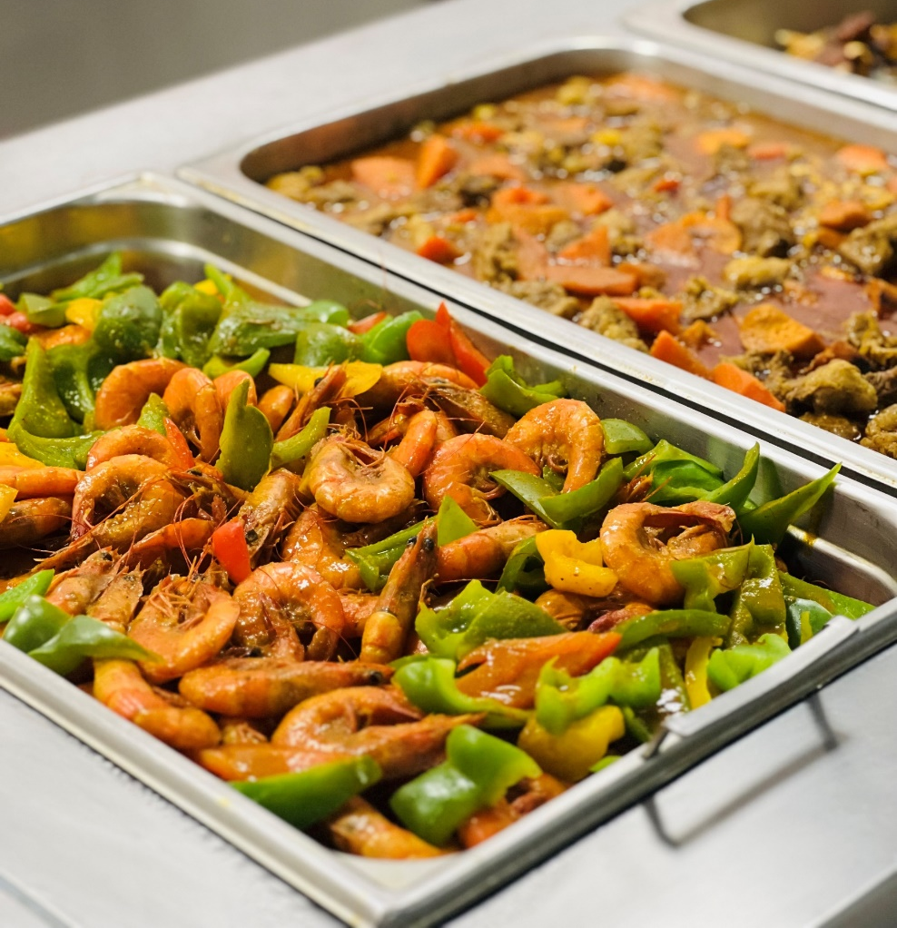
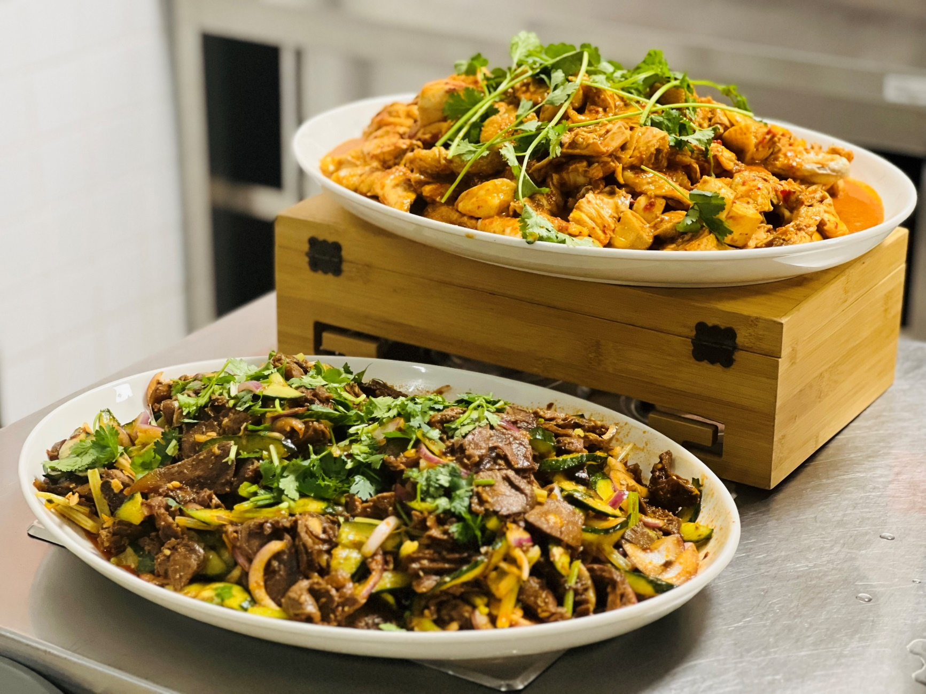
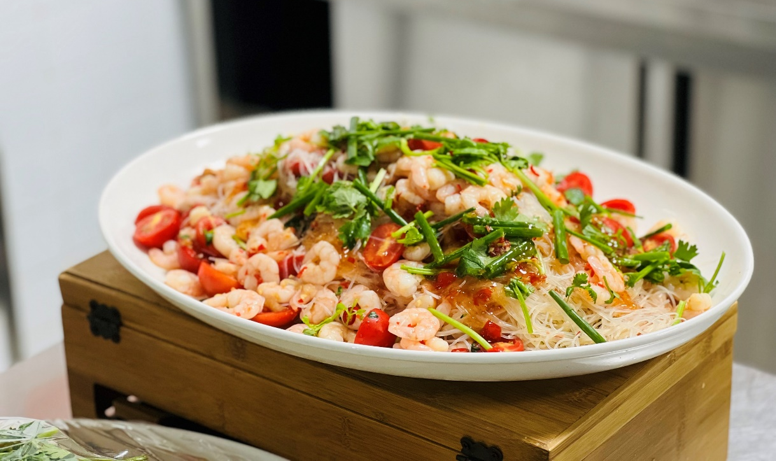
嘉入卓越 星途璀璨 CRAFTING YOUR LEGENDARY JOURNEY WITH CAPELLA
员工餐-嘉厨

Slide 7
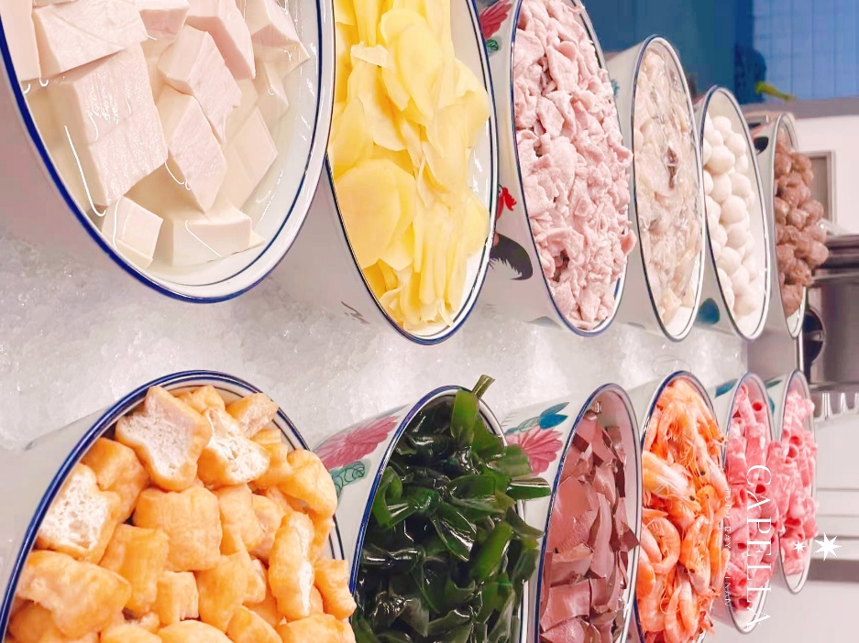
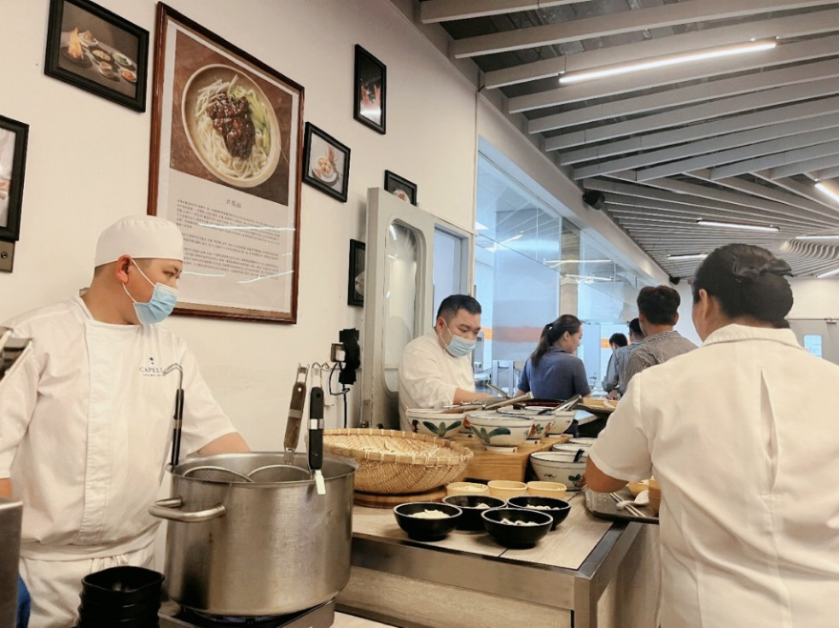
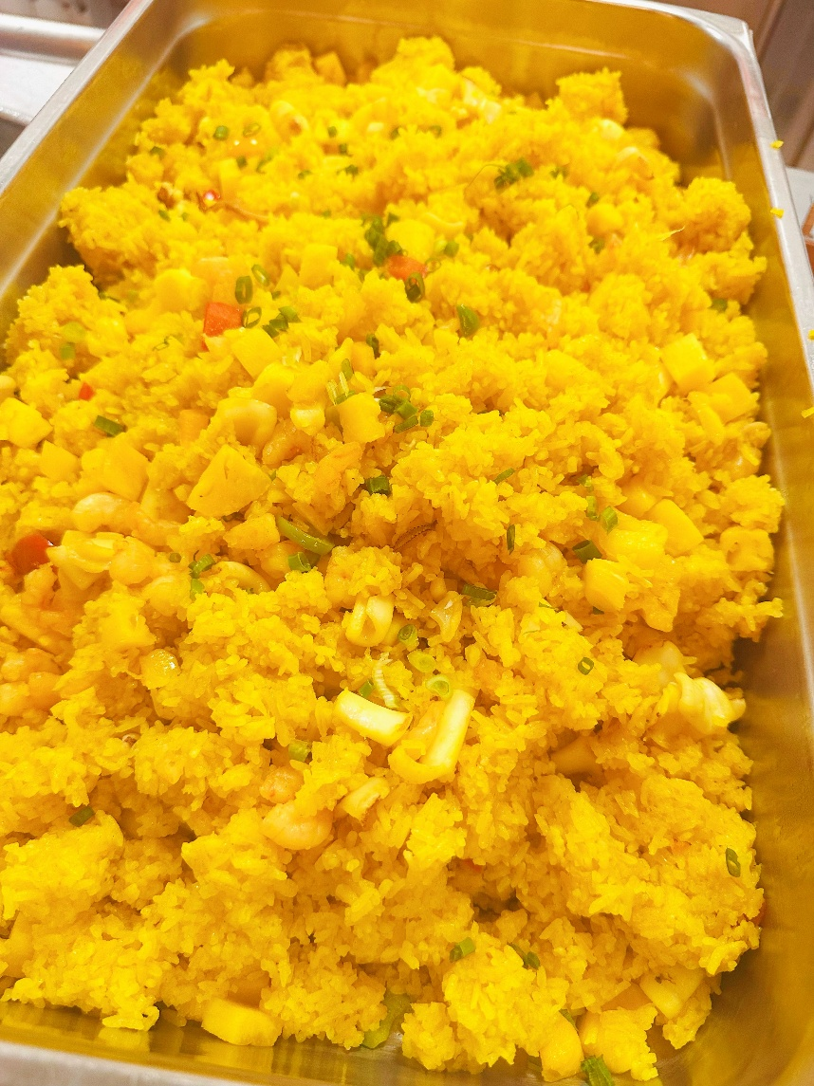
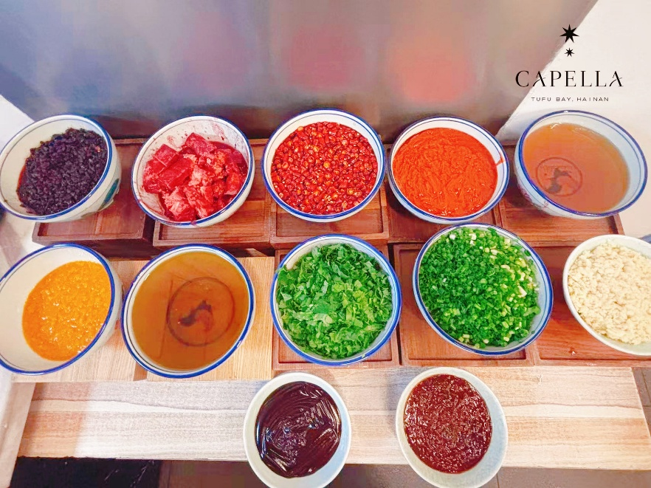
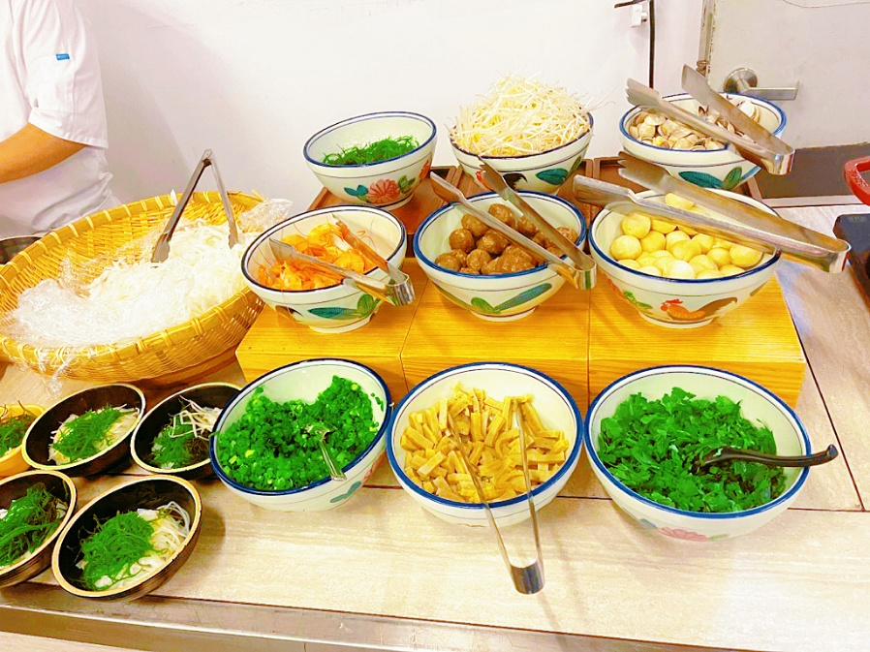
嘉入卓越 星途璀璨 CRAFTING YOUR LEGENDARY JOURNEY WITH CAPELLA
员工餐-嘉厨
日常加餐：炸酱面和糟泊醋、麻辣烫、菠萝炒饭

Slide 8

嘉入卓越 星途璀璨 CRAFTING YOUR LEGENDARY JOURNEY WITH CAPELLA
2 sharing dormitory & shuttle bus
双人宿舍及员工班车
Free meals in hotel and dormitory
酒店及宿舍员工餐厅全免
Split shift and night shift allowance
两头班和夜班津贴
Departmental incentives
各部门相关的津贴奖励
Outstanding Trainee Monthly Award
月度优秀实习生奖励
PH 300% pay
法定节假日三倍工资支付
8 days off per month
月休8天
After convert to fulltime will enjoy global colleague escape rate
转正即享全球员工价

Slide 9


嘉入卓越 星途璀璨 CRAFTING YOUR LEGENDARY JOURNEY WITH CAPELLA
职位空缺
丝路餐厅实习生 Silk Road Trainee | 2 |  | 礼宾部实习生 Concierge Trainee | 5
兰亭中餐厅实习生 Lanting Trainee | 2 |  | 财务部实习生 Finance Trainee | 1
Saibai Sabai 餐厅实习生 Sabai Sabai Trainee | 2 |  | 客房部实习生 Housekeeping Trainee | 4
文旅官实习生 Culturist Trainee | 2 |  | 康乐部实习生 Recreation Trainee | 3
送餐部实习生 In Room Daining | 2 |  | 总机实习生 Communications Trainee | 2
市场销售部实习生 Sales & Marketing Trainee | 1 |  | 水疗实习生 SPA Trainee | 1
西厨房实习生 West Kitchen Trainee | 1 |  | 泰餐厅厨房实习生 Sabai Kitchen Trainee | 1

Slide 10
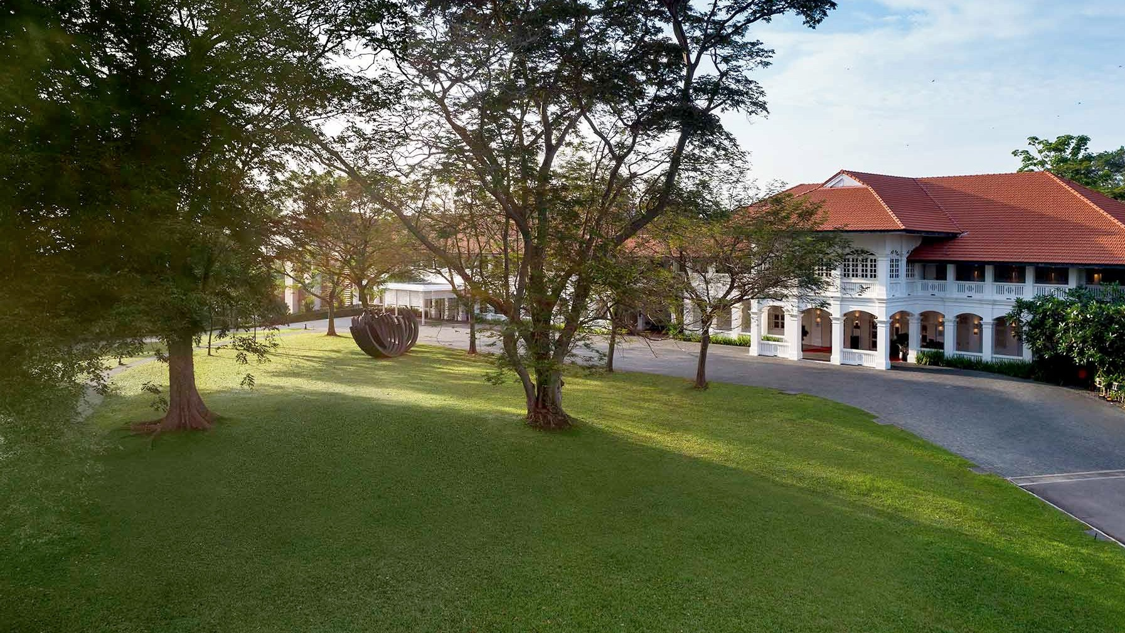

嘉入卓越 星途璀璨 CRAFTING YOUR LEGENDARY JOURNEY WITH CAPELLA
请“嘉人”扫码“回嘉”交流更多信息

